Slide 1
An overview of Islington’s Health and Wellbeing Board
Notes:
Before outlining the roles and responsibilities of the Health and Wellbeing Board I’d like to ask the question – how do we know what the health and wellbeing needs of the our population are?

Slide 2
What is a Health and Wellbeing Board?
Health and Wellbeing Boards are…
A statutory function of the local authority.
The means by which the local authorities will deliver their new duties to improve strategic coordination across local NHS, social care, children’s services, public health and other services that directly relate to health and wellbeing.
Notes:
As set out in the health and social care bill
The HWBB will be a statutory function of the Local Authority and is expected to increase democratic legitimacy in health. It will play a strategic coordinating role, joining up commissioning across the NHS, adult social care, children’s services, public health and other services that directly relate to health and wellbeing, in order to improve outcomes for the local population.
The work of the health and wellbeing board should be underpinned by the need described in the JSNA

Slide 3
Key functions of the Health and Wellbeing Board.
Assess the needs of the population through the Joint Strategic Needs Assessment
Agree and produce a Health and Wellbeing Strategy
Promote joint commissioning
Promote integrated provision joining up social care, public health and NHS services with wider local authority services
Ensure best use of resources
Consider the wider determinants of health

Slide 4
Who is on the board?
Leader of the Council
Lead Member for Health and Adult Social Services
Lead Member for Children’s Services
Clinical Commissioning Group representation
Borough Director
Director of Housing, Adult and Social Services
Director of Children and Families Services
Director of Public Health
Local Health Watch representation
Notes:
In Islington representation from the Islington CCG includes:
Membership from all key partners including the Chair and Co-Vice Chair of the Islington CCG and the LMC representative.

Slide 5
Governance and accountability
Accountability for the HWBB resides with the local authority
Members of the board will be held to account through different routes.
The board will set priorities for health and wellbeing through the Joint Health and Wellbeing Strategy that will reflect the national outcome frameworks for Public Health, NHS and Adult Social Care currently under consultation.
Duty to regard the NHS Commissioning Board and Secretary of State for Health through preparation of the JSNA and JHWS
Notes:
Overall responsibility for the HWB lays wit the local authority and board members will be held to account through different avenues.
However they will be brought together and work collaboratively to address identified need and priority actions outlined in the JHWS.

Slide 6
Relationship between the Health and Wellbeing Board and the Voluntary and Community Sector.
The public and patient voice is represented by the LINk and will continue to be through Healthwatch as these are established by April 2012.
The HWB will engage wider partners in the voluntary and community sector through assessment of local health and wellbeing needs.
Additionally there are roles for the voluntary and community sector in supporting the work of the health and wellbeing board through:
Market transformation: working with communities to support change and shift demand for service provision
Supporting commissioners: working with commissioners to better understand voluntary sector commissioning and how processes can be improved to achieve better outcomes for beneficiaries

Slide 7
Benefits of engaging with the voluntary and community sector.
Specific benefits include
bringing a wider perspective; reflective of different localities and communities.
delivering messages to where they are needed most
crossing the health and social care boundaries
drawing together broad experience and expertise
providing a ‘live’ feed-back loop from experience to policy

Slide 8
Where we are in Islington.
The Islington Health and Wellbeing Board is in it’s infancy with a membership that reflects that proposed nationally.
There are established terms of reference and a draft forward programme that sets out key commissioning and strategy milestones.
Based on evidence within the Islington Joint Strategic Needs Assessment the board has set 3 overarching health and wellbeing priorities for the borough.
The board are focusing on combining their skills, knowledge and experience to identify what levers they, as a whole and as individuals, can use to bring about change
Notes:
Although the Islington HWB is in it’s infancy it is being developed on the back of strong existing partnerships between the voluntary sector, council, local NHS and primary care. At a recent development day board members were explicit in the need to build on these relationships whilst learning from the past and maintaining links across organisations as sectors continue to scale up.
They acknowledged the unique opportunities the board provided for cross fertilisation of knowledge and skills to work with common intent to improve Health and wellbeing outcomes in Islington.
The board have also set four over arching health and well being priorities for Islington.

Slide 9
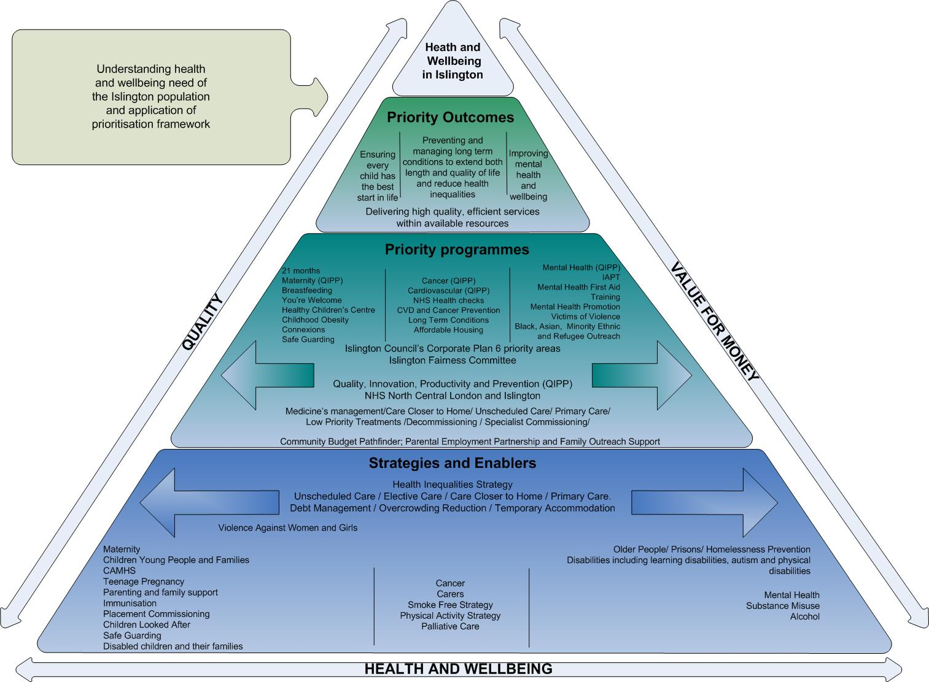
Priorities
Notes:
The over arching priorities are:
Ensuring every child has the best start in life
Preventing and managing long term conditions
Improving mental health and wellbeing.
Three are explicitly based on an understanding and assessment of population health need. The priorities are based on evidence within the Islington JSNA that have been informed by the work with the voluntary and community sector through targeted focus groups/calls for evidence and residential questionnaires.
The fourth, no less important priority reflects the need to address the unprecedented financial challenge facing Islington and the other boroughs across NCL, as well as the need to drive up and reduce variation in the quality of local services.
It is hoped that, through the elucidation of three overarching priorities firmly rooted in population health need, a clear focus on improving health and addressing health inequalities will be sustained.

Slide 10
Ensuring every child has the best start in life
Events in early years, even pre-birth have lifelong effects on health and wellbeing from obesity, heart disease and mental health to educational achievement and economic status (Marmot, 2010).
Mortality in the perinatal period is of concern, a main risk factor being poverty.
Childhood immunisation coverage, although improving remains below national targets.
1 in 10 of Islington’s Reception Year children are obese and 1 in 4 Year 6 children leave school obese.
Notes:
The board have agreed to initially focus work under the priority area – Ensuring Every Child Has the Best Start in Life – around the First 21 Months of Life.
Focusing on one area will enable the board to develop and evaluate ways of working and joint approaches that can then be taken across breadth covered by the priorities highlighted.

Slide 11
Working together on the First 21 Months of Life
Notes:
There are a wide range of services and interventions available during this period for families and children.
Bringing the board together has started to highlight the strengths, weaknesses in current delivery and opportunities and barriers to making changes.
The role of the voluntary and community sector within this specific piece of work could involve consulting with young and new parent support and advocacy community groups.

